Slide 1
Brief Incomplete History of Computing
ICS 111
Cam Moore
Information and Computer Sciences
University of Hawaii, Manoa

Slide 2
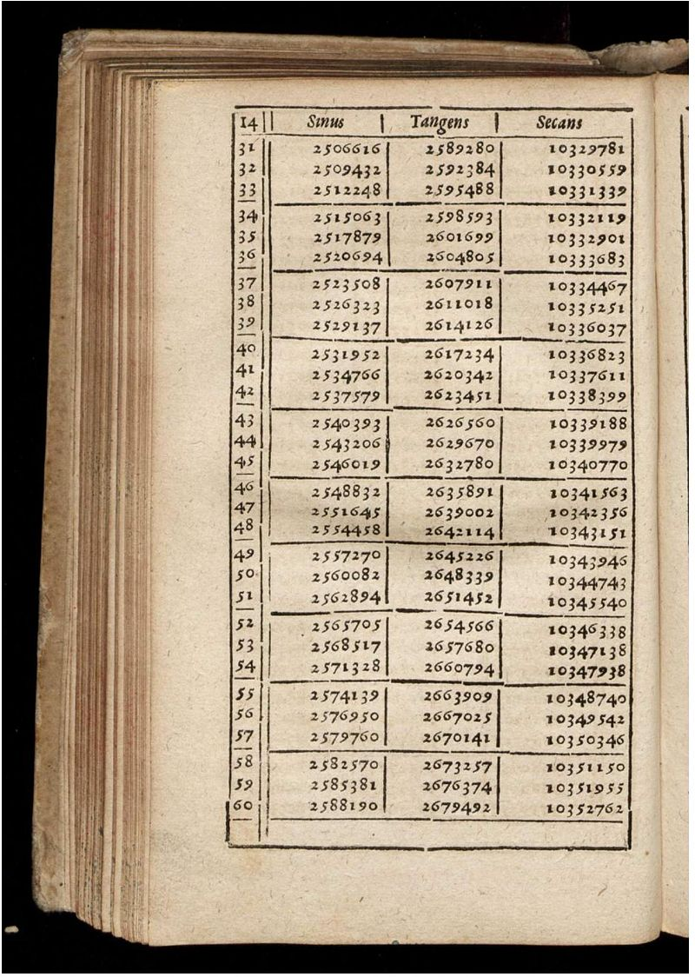
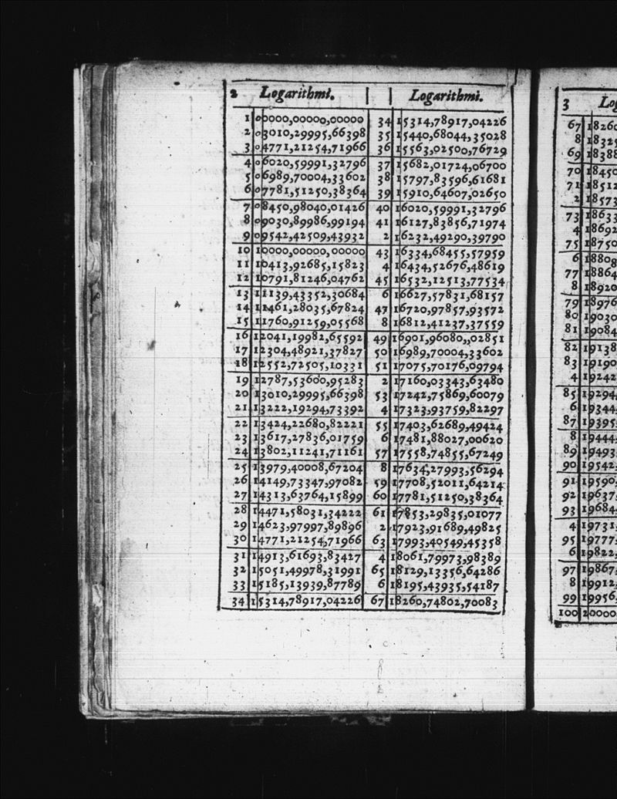
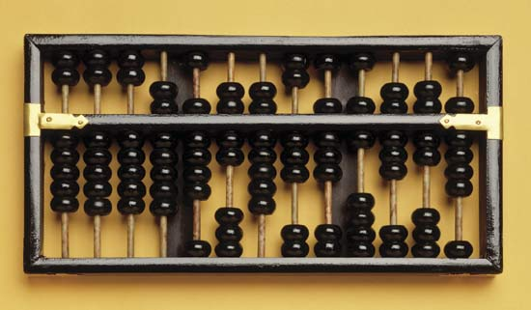
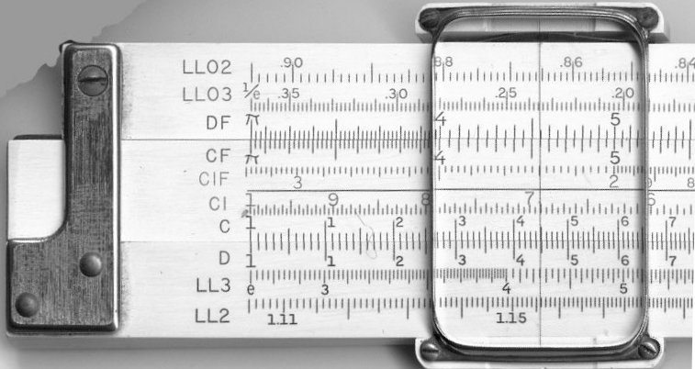
Manual Era
Before the 19th Century
Tools
Abacus
Addition, subtraction
Mathematical Tables
Trigonometric functions
Logarithms
Slide rule
Multiplication, division
1800
1900
2000

Slide 3
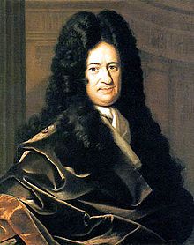
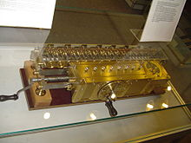
Mechanical Era
Late 18th Century
Gottfried Leibniz
Binary Numbers
Formal Logic
Calculating Machines
Stepped Reckoner
Addition, Subtraction
Multiplication, Division
c
1800
1900
2000

Slide 4
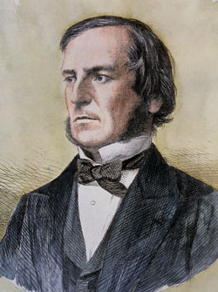
Mechanical Era
19th Century
George Boole
Differential Equations
Boolean logic
And, Or, Not
c
1800
1900
2000

Slide 5
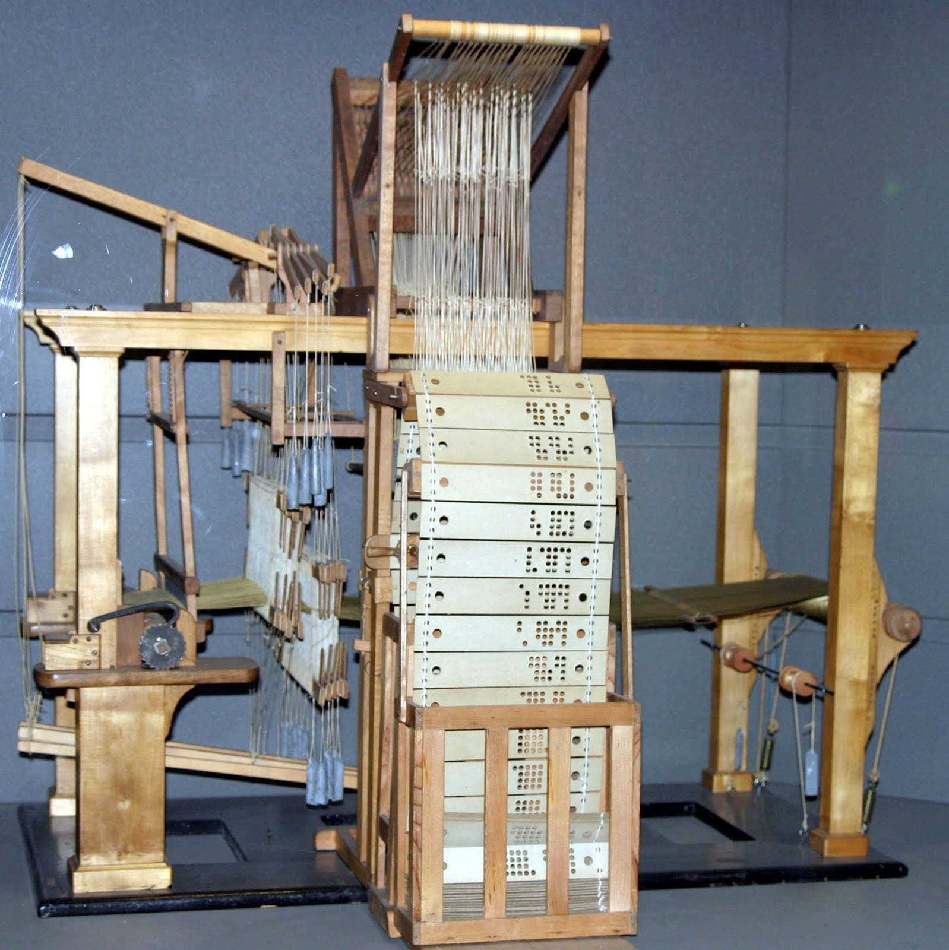
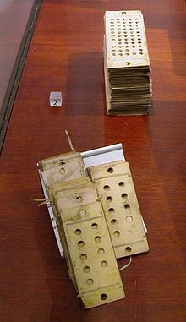
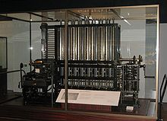
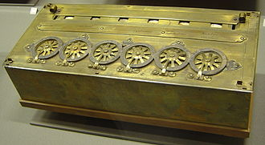
Mechanical Era
Late 19th Century
Tools
Pascaline
Jacquard Loom
Punch cards
Difference Engine
Analytical Engine
c
1800
1900
2000

Slide 6
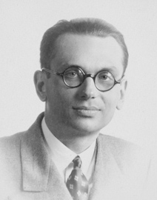
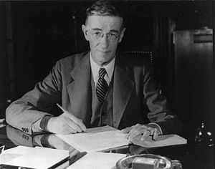
Electronic Era
1930s
Kurt Gödel
Recursion
Vannevar Bush
Memex
Hypertext
Personal Computers
WWW
Internet
1800
1900
2000

Slide 7
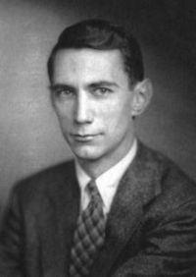
Electronic Era
1940s
Claude Shannon
Boolean Algebra
Binary Arithmetic
Information Theory
1800
1900
2000

Slide 8
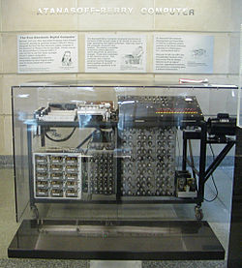
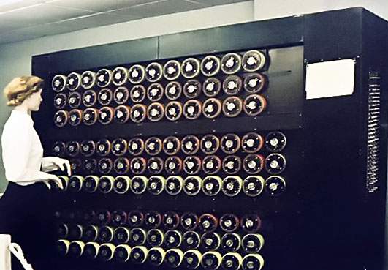
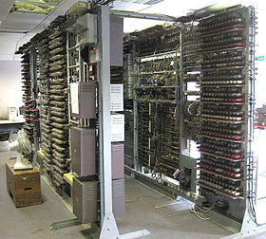

Electronic Era
1930s
Atanasoff Berry Computer
Bombe
Colossus
ENIAC
1800
1900
2000

Slide 9

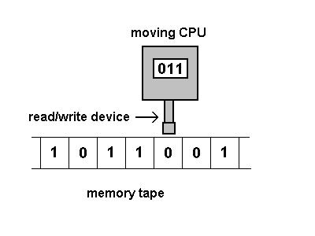
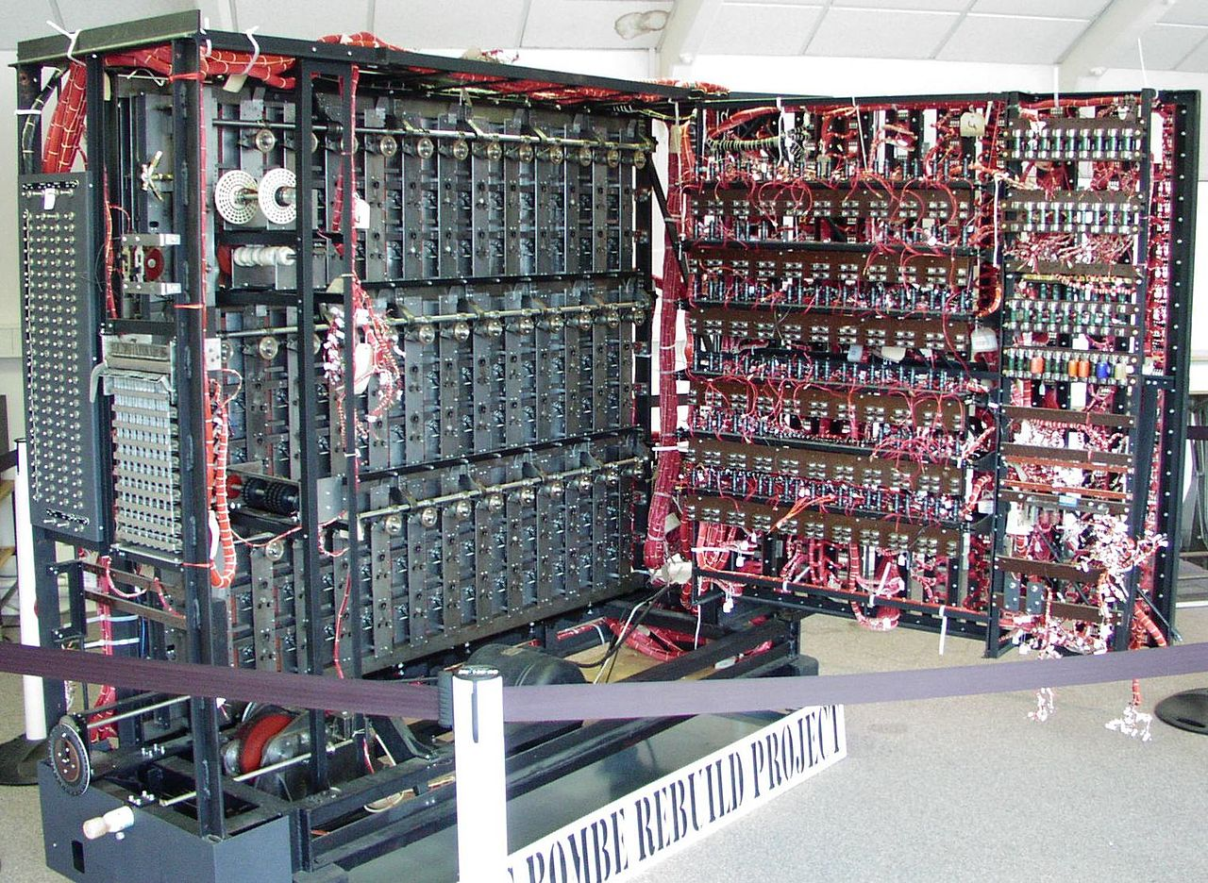
Electronic Era
1940s – 50s
Alan Turing
Bombe
Stored-program Computer
Turing Machine
Turing Test
1800
1900
2000

Slide 10

Electronic Era
1940s – 50s
John von Neumann
Report on EDVAC
von Neumann Architecture
Central Processing Unit
Control Unit
Arithmetic/Logic Unit
Input
Device
Output
Device
Memory Unit
1800
1900
2000

Slide 11
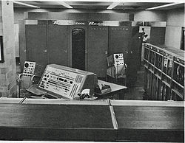
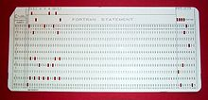
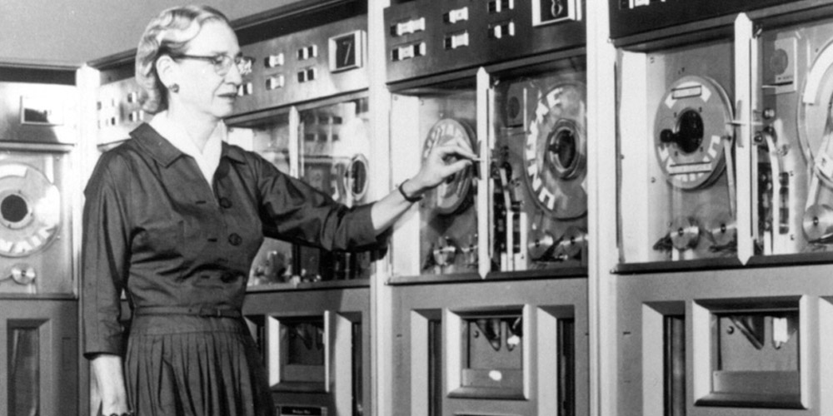
Electronic Era
1930s – 1995
UNIVAC
Vacuum tubes
Magnetic Tape
Punch cards
1800
1900
2000

Slide 12
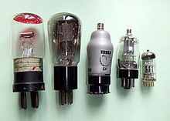
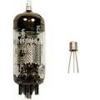
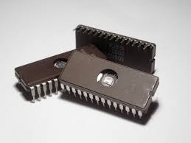
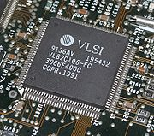
Electronic Era
1930s – 1995
Miniaturization
Moore’s Law
1800
1900
2000

Slide 13
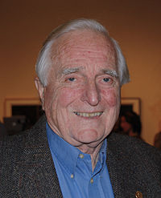
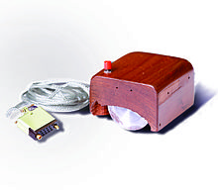
Electronic Era
1960s – 70s
Douglas Engelbart
Mouse
Hypertext
Networked Computers
GUIs
Human-Computer Interaction
1800
1900
2000

Slide 14




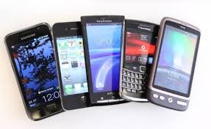



Internet Era
Connectivity
Cloud Computing / Storage
Mobile Devices
1800
1900
2000

Slide 15
Next?
Singularity?
When Humans do none of the Computing
?
1800
1900
2000

